Slide 1
Internet Architecture
Aj.Drusawin Vongpramate
Information Technology
Science, BRU

Slide 2
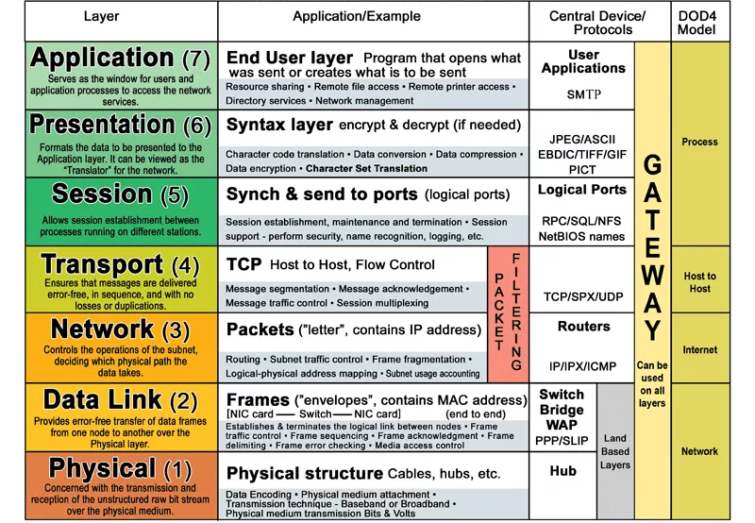
Network Model

Slide 3
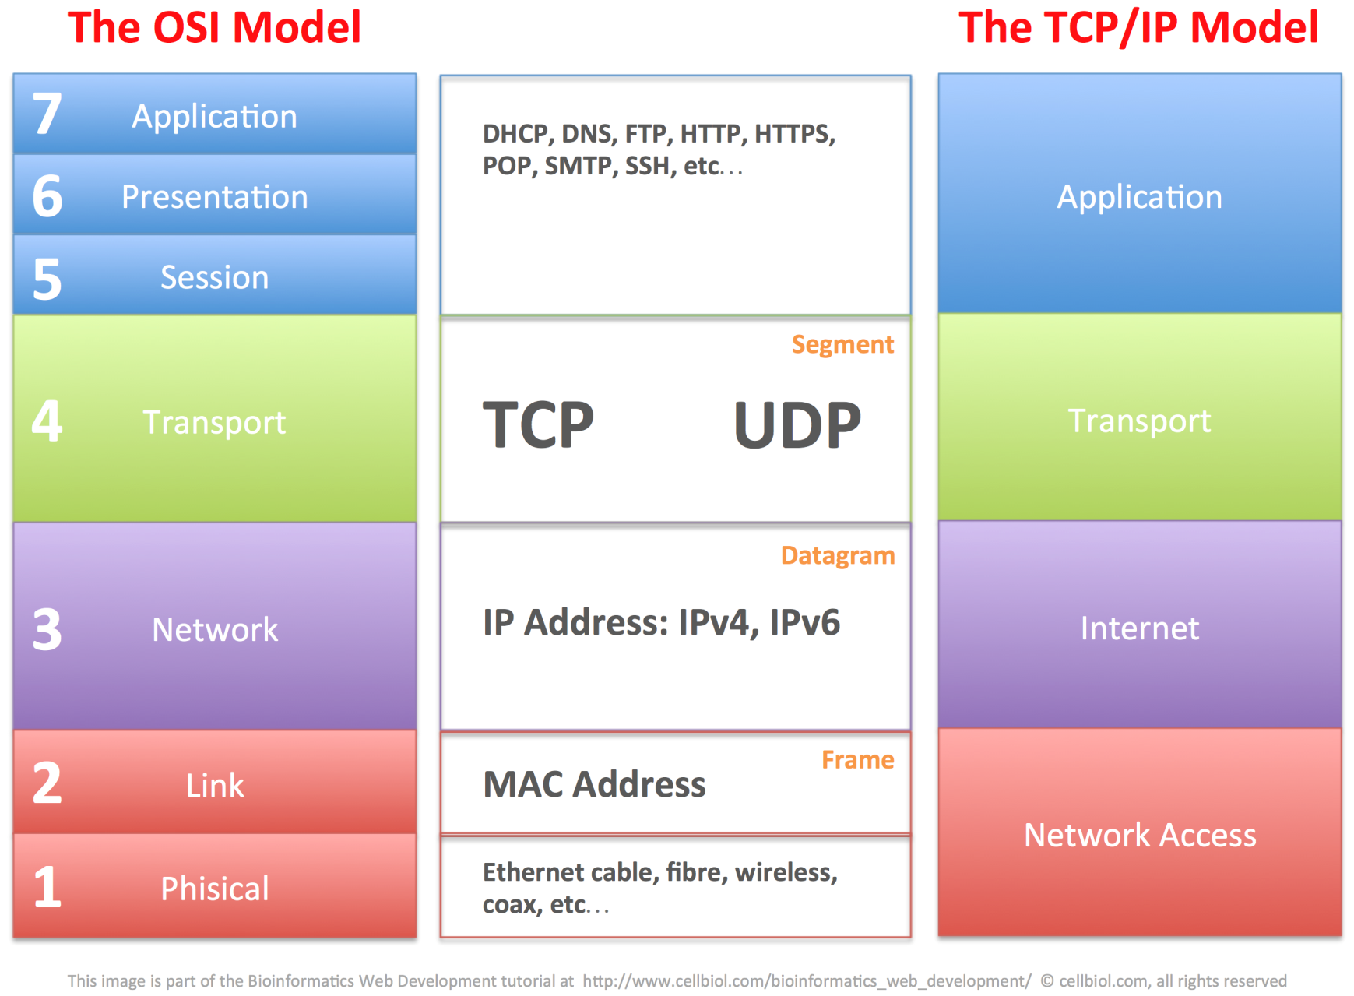
Internet (TCP/IP) Model

Slide 4
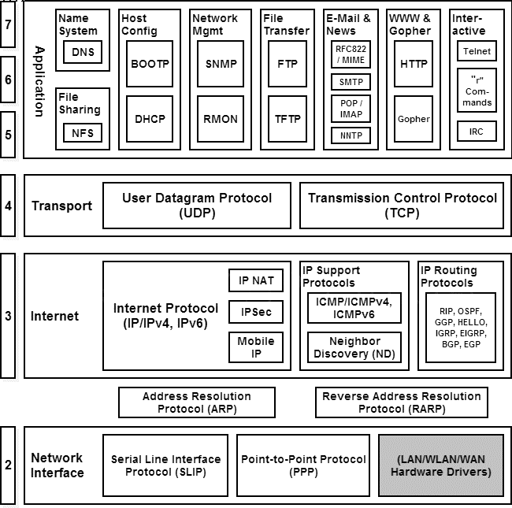

Slide 5
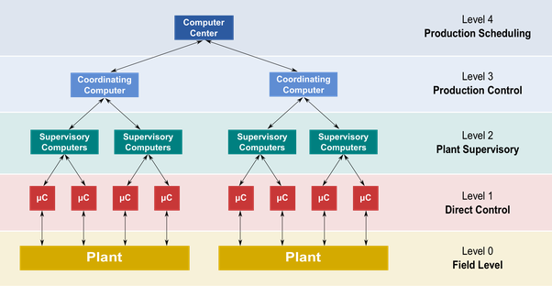
Applications
Distributed Computing
Grid Computing
Cloud Computing
Virtualization
Internet of Things
Etc.

Slide 6
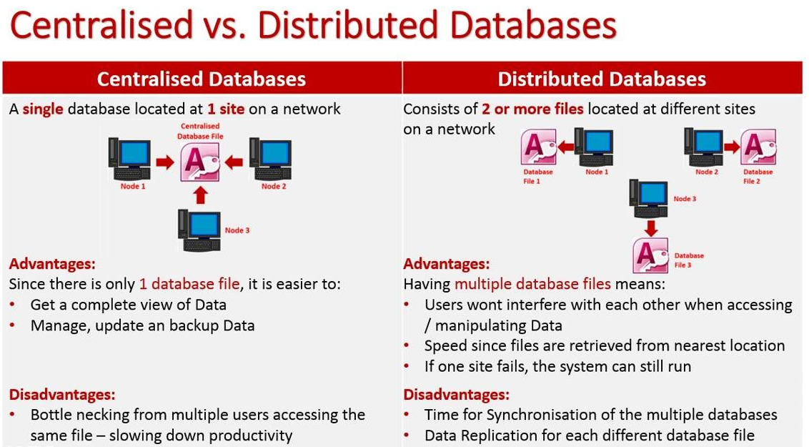
Ref : https://www.youtube.com/watch?v=QjvjeQquon8

Slide 7
Grid Computing
A computer network in which each computer's resources are shared with every other computer in the system. Processing power, memory and data storage are all community resources that authorized users can tap into and leverage for specific tasks. A grid computing system can be as simple as a collection of similar computers running on the same operating system or as complex as inter-networked systems comprised of every computer platform you can think of.

Slide 8
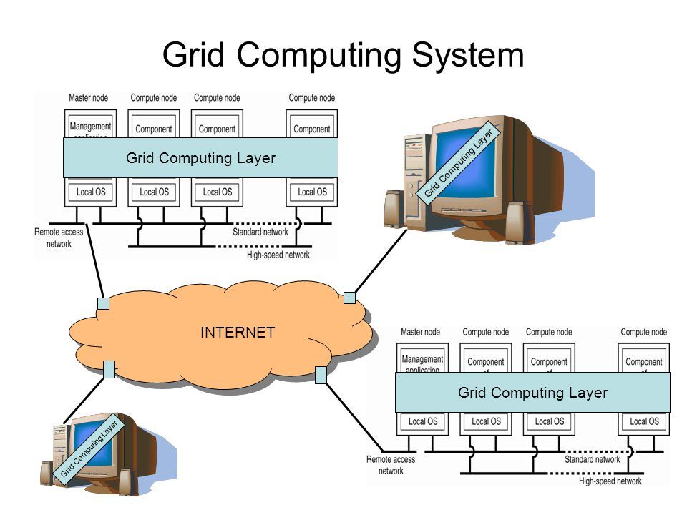

Slide 9
Cloud Computing
Cloud computing has been trending in today’s technology-driven world for years now, and with good reason. Cloud computing offers many advantages with flexibility, storage, sharing and easy accessibility, cloud computing is being used by companies of all sizes. Even at home, we use cloud technologies for various daily activities. From Google Docs to OneDrive to Skype and Spotify, these services are provided to us through virtual networks.
Ref : https://www.w3schools.in/cloud-computing/cloud-computing/

Slide 10
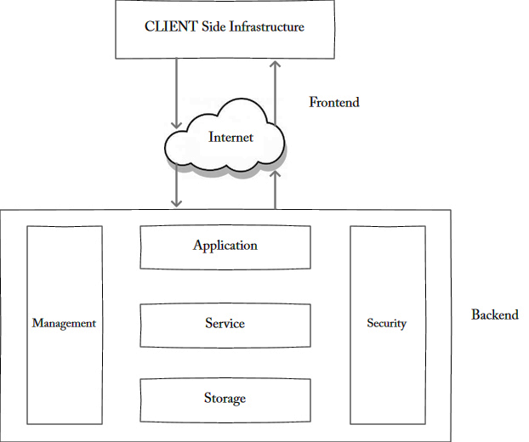
Cloud Computing

Slide 11
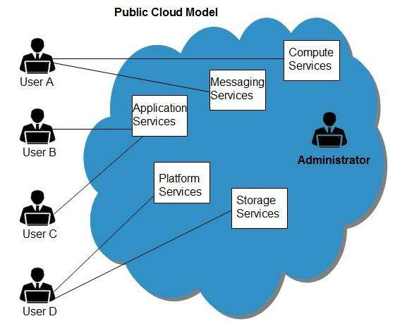
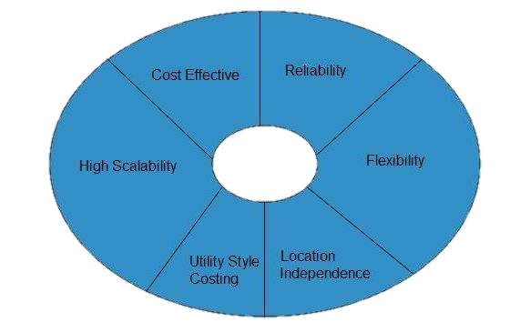
Cloud Computing

Slide 12
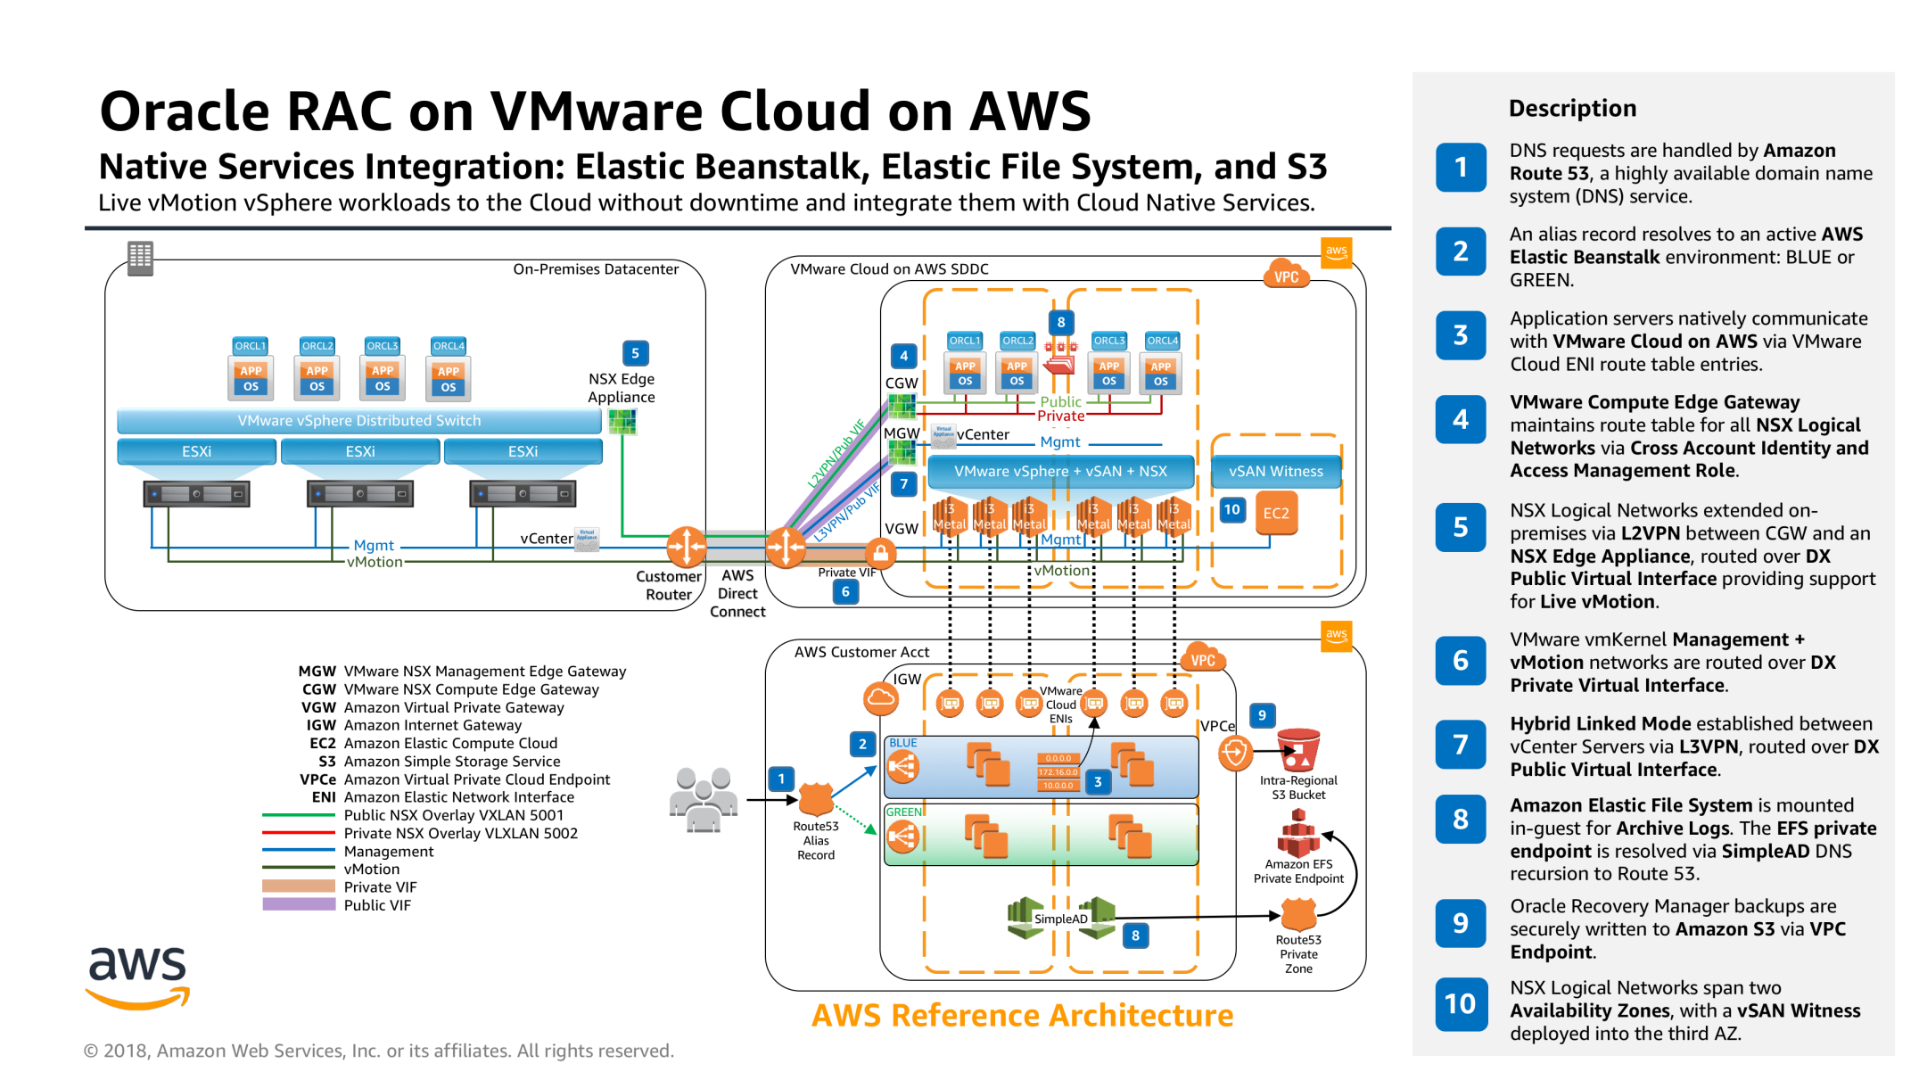
Cloud Computing

Slide 13
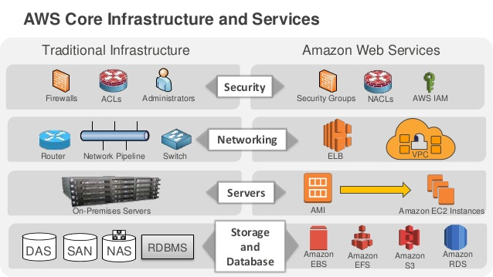
Cloud Computing

Slide 14
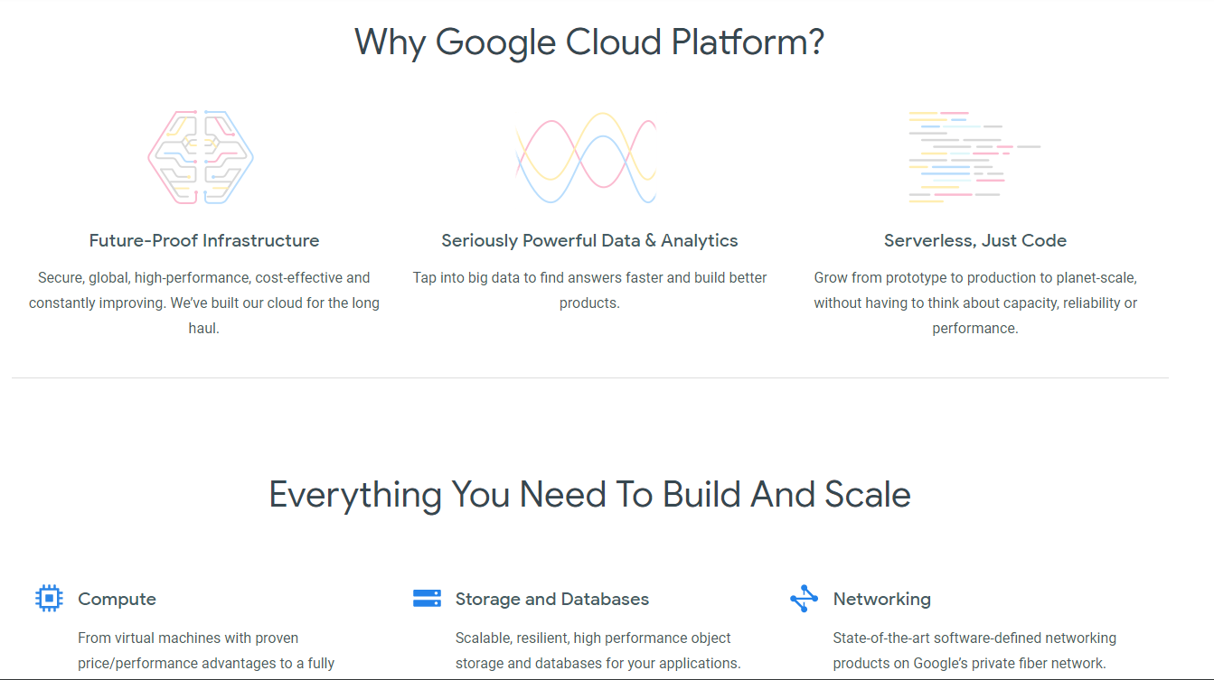
Example : https://cloud.google.com

Slide 15
Internet of things (IoT)
The extension of Internet connectivity into physical devices and everyday objects. Embedded with electronics, Internet connectivity, and other forms of hardware (such as sensors), these devices can communicate and interact with others over the Internet, and they can be remotely monitored and controlled
Ref : https://en.wikipedia.org/wiki/Internet_of_things

Slide 16
Internet of things (IoT)
The definition of the Internet of things has evolved due to the convergence of multiple technologies, real-time analytics, machine learning, commodity sensors, and embedded systems. Traditional fields of embedded systems, wireless sensor networks, control systems, automation (including home and building automation), and others all contribute to enabling the Internet of things.

Slide 17
Internet of things (IoT)
In the consumer market, IoT technology is most synonymous with products pertaining to the concept of the "smart home", covering devices and appliances (such as lighting fixtures, thermostats, home security systems and cameras, and other home appliances) that support one or more common ecosystems, and can be controlled via devices associated with that ecosystem, such as smartphones and smart speakers.

Slide 18
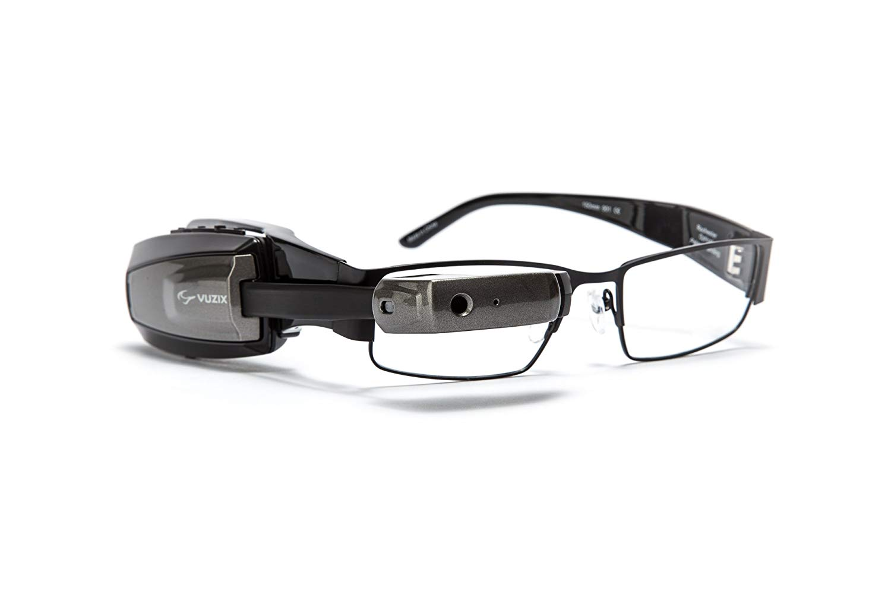
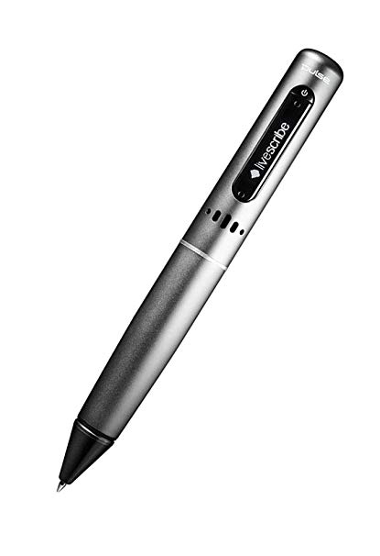
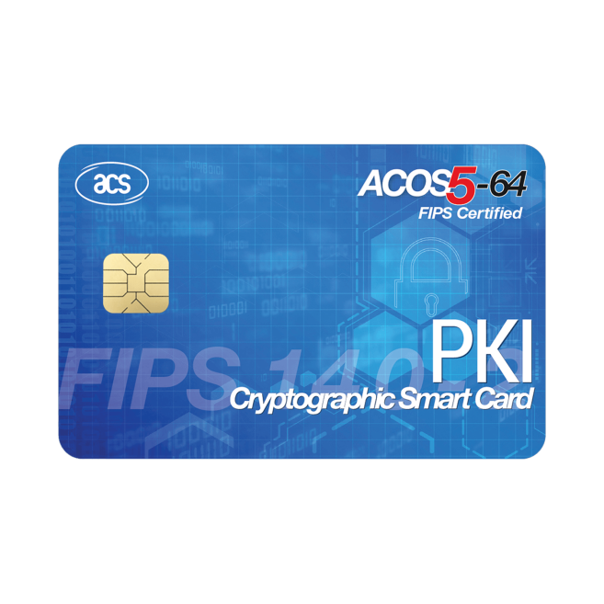
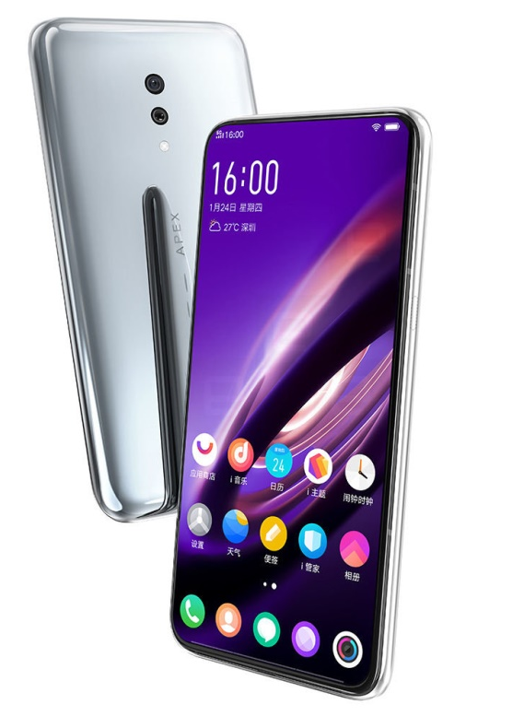
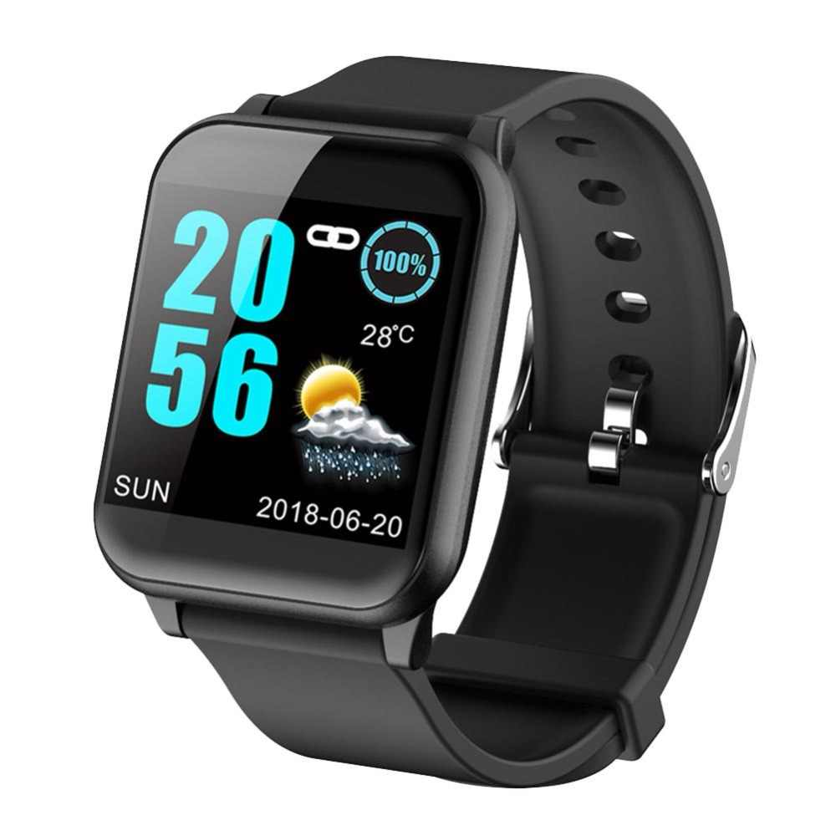
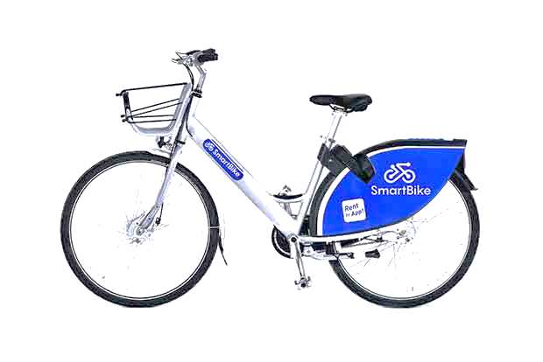
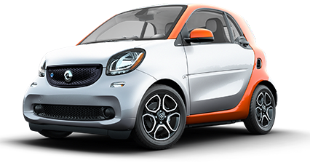

Slide 19
Basic elements of IoT architecture
Our approach to IoT architecture is reflected in the IoT architecture diagram which shows the building blocks of an IoT system and how they are connected to collect, store and process data.
Ref : https://www.scnsoft.com/blog/iot-architecture-in-a-nutshell-and-how-it-works

Slide 20
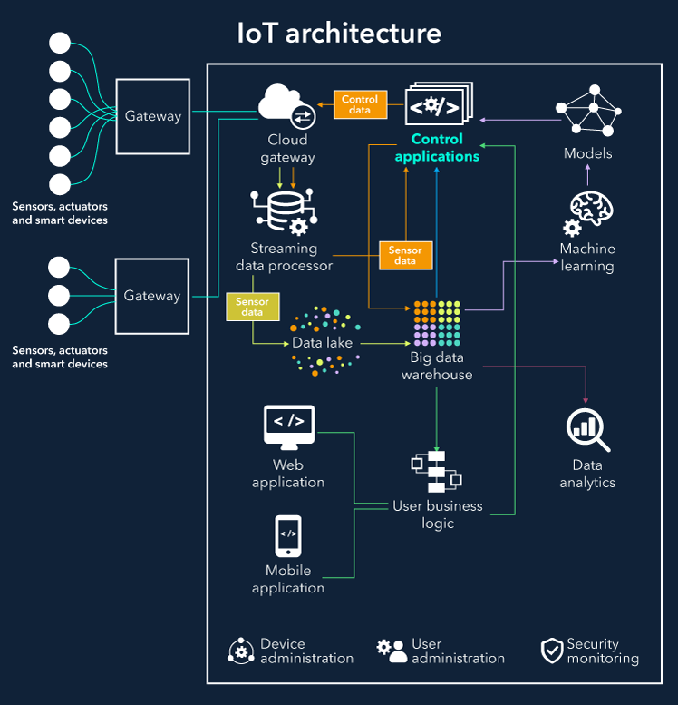

Slide 21
IoT architecture
Things. A “thing” is an object equipped with sensors that gather data which will be transferred over a network and actuators that allow things to act (for example, to switch on or off the light, to open or close a door, to increase or decrease engine rotation speed and more). This concept includes fridges, street lamps, buildings, vehicles, production machinery, rehabilitation equipment and everything else imaginable. Sensors are not in all cases physically attached to the things: sensors may need to monitor, for example, what happens in the closest environment to a thing.

Slide 22
IoT architecture
Gateways. Data goes from things to the cloud and vice versa through the gateways. A gateway provides connectivity between things and the cloud part of the IoT solution, enables data preprocessing and filtering before moving it to the cloud (to reduce the volume of data for detailed processing and storing) and transmits control commands going from the cloud to things. Things then execute commands using their actuators.

Slide 23
IoT architecture
Cloud gateway facilitates data compression and secure data transmission between field gateways and cloud IoT servers. It also ensures compatibility with various protocols and communicates with field gateways using different protocols depending on what protocol is supported by gateways.
Streaming data processor ensures effective transition of input data to a data lake and control applications. No data can be occasionally lost or corrupted.

Slide 24
IoT architecture
Data lake. A data lake is used for storing the data generated by connected devices in its natural format. Big data comes in "batches" or in “streams”. When the data is needed for meaningful insights it’s extracted from a data lake and loaded to a big data warehouse.

Slide 25
IoT architecture
Big data warehouse. Filtered and preprocessed data needed for meaningful insights is extracted from a data lake to a big data warehouse. A big data warehouse contains only cleaned, structured and matched data (compared to a data lake which contains all sorts of data generated by sensors). Also, data warehouse stores context information about things and sensors (for example, where sensors are installed) and the commands control applications send to things.

Slide 26
IoT architecture
Data analytics. Data analysts can use data from the big data warehouse to find trends and gain actionable insights. When analyzed (and in many cases – visualized in schemes, diagrams, infographics) big data show, for example, the performance of devices, help identify inefficiencies and work out the ways to improve an IoT system (make it more reliable, more customer-oriented). Also, the correlations and patterns found manually can further contribute to creating algorithms for control applications.

Slide 27
IoT architecture
Machine learning and the models ML generates. With machine learning, there is an opportunity to create more precise and more efficient models for control applications. Models are regularly updated (for example, once in a week or once in a month) based on the historical data accumulated in a big data warehouse. When the applicability and efficiency of new models are tested and approved by data analysts, new models are used by control applications.

Slide 28
Example – Intelligent lighting
Let’s see how our IoT architecture elements work together by the example of smart yard lighting as a part of a smart home – a bright illustration of how an IoT solution simultaneously contributes to user convenience and energy efficiency. There are various ways a smart lighting system can function, and we’ll cover basic options.

Slide 29
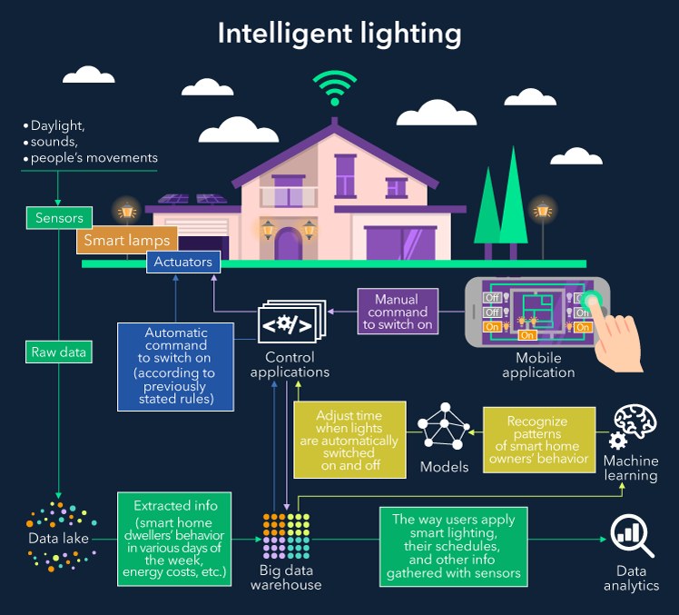

Slide 30
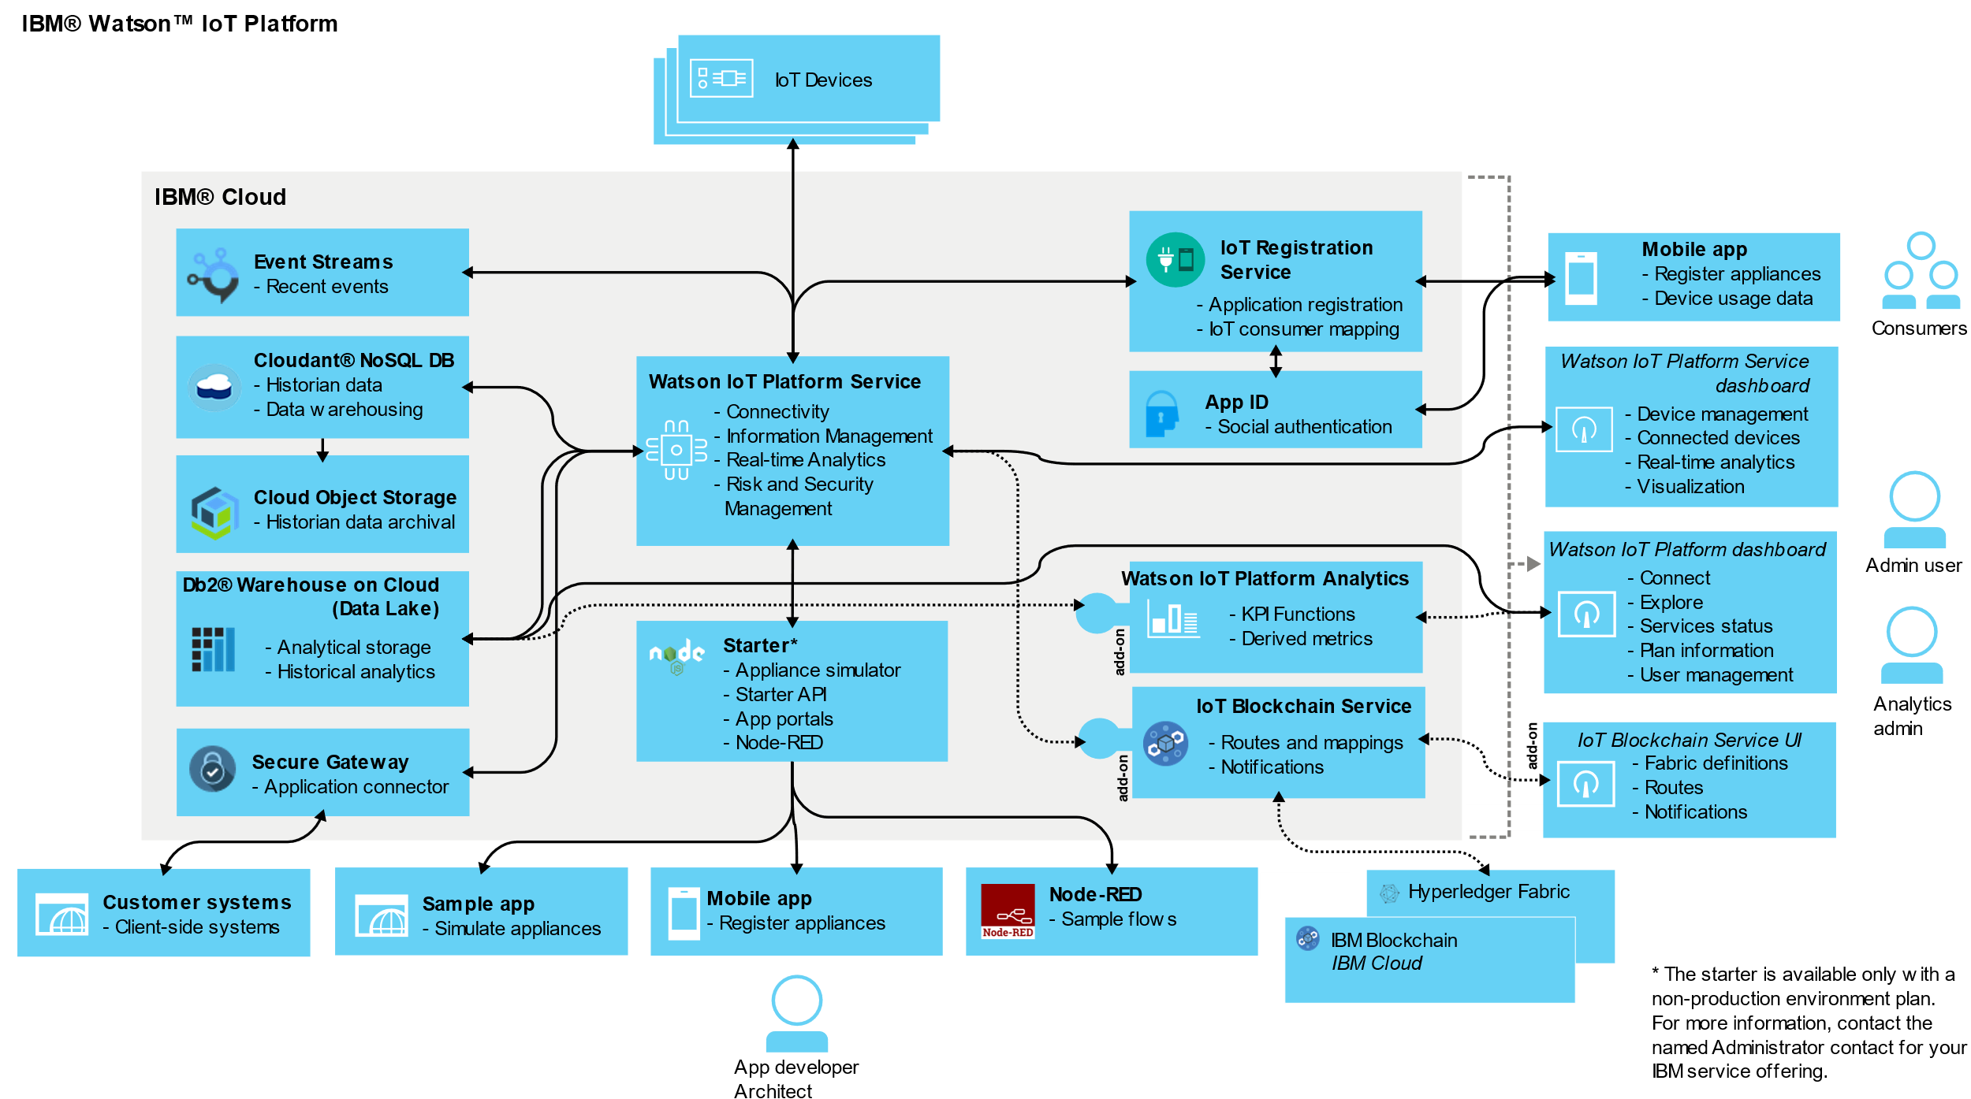
Other IoT Platform

Slide 31
Q & A

